Slide 1
SportsPA
Final Year Project
Ger Dobbs
Superviser: Mr. Paul Barry
Date: 23/03/2018

Slide 2
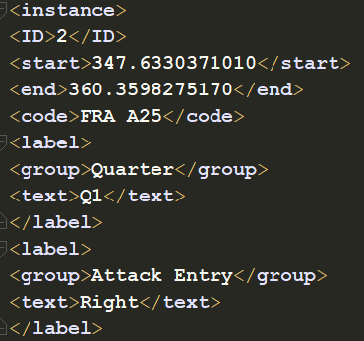
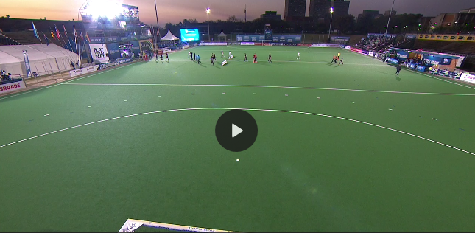
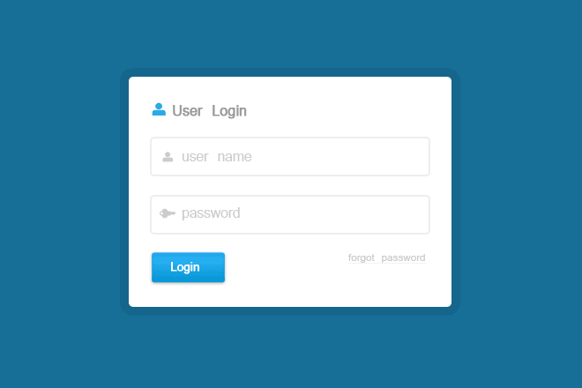
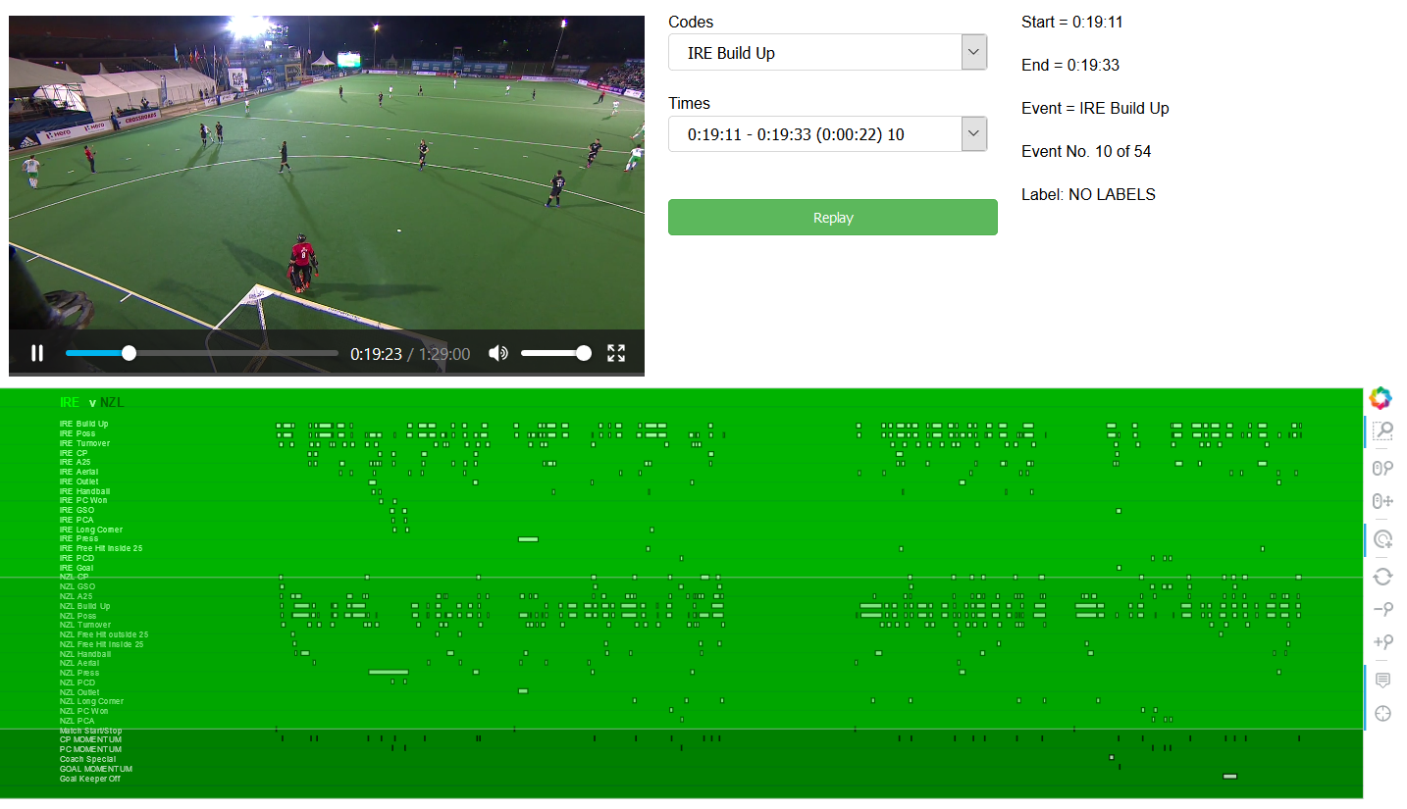
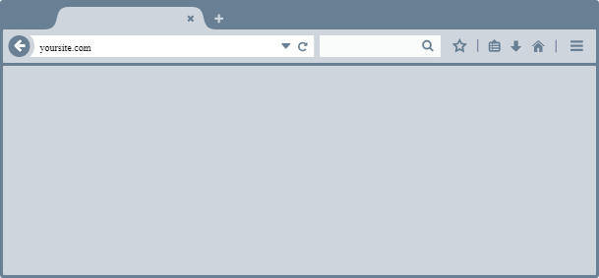
Reminder what the project involves
Gamebreaker
SportsPA
SportsPA

Slide 3
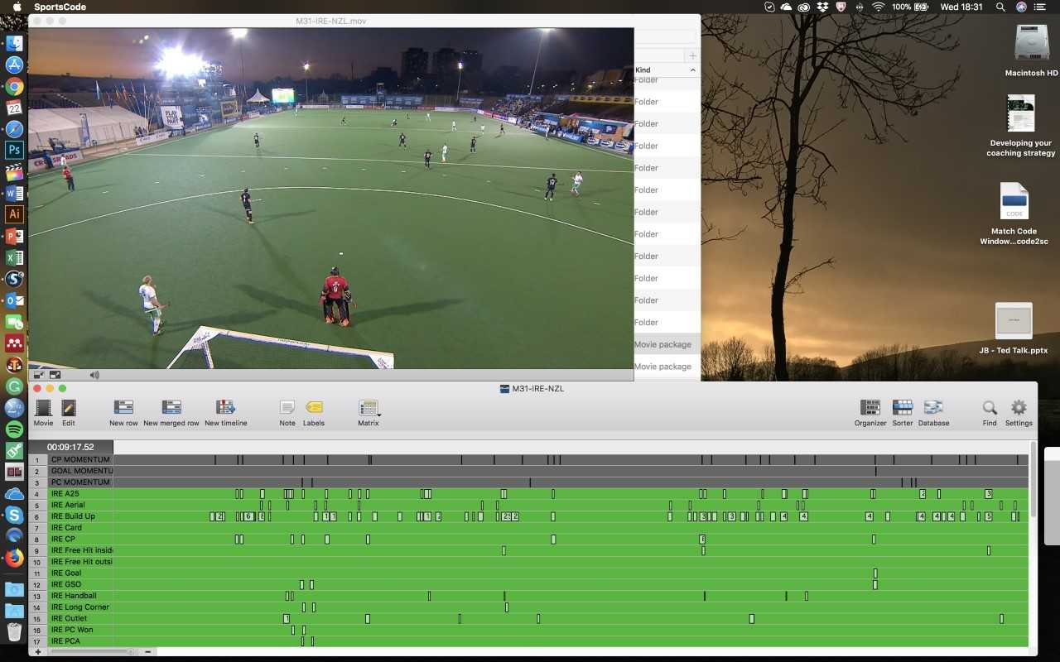
SportsTec

Slide 4
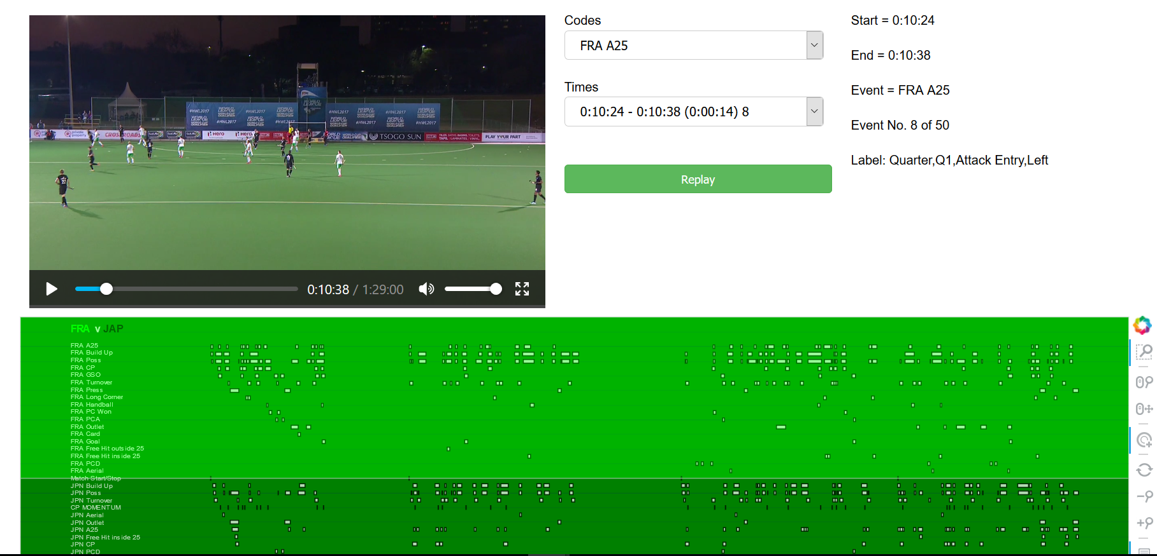
Review- What has been achieved

Slide 5
Plan for Final Iteration
Create Web App
Host on Glasnost
Store videos and xml file
Admin logs in to upload Video & XML files
Students select files to analyse events
Display analysis

Slide 6
Thanks!
All for listening
Paul Barry
Johnny Bradley
Questions?

